Slide 1
Plan

Slide 2
Plan Activities
Plan Communication
Plan Project
Plan Releases
Estimate
Kick-off Project
Project Management
Plan
Plan Iteration
Monitor & Adapt
Kick-off Iteration
Set-up TAR Management Environment

Slide 3


Plan Communication
Purpose:
  Create communication strategy that is targeted and efficient
Objective:
  Craft a plan that effectively addresses the project's key internal and external communication needs
Activities:
  Capture contact information of all stakeholders including team members, client and third parties.
  Document all recurring communication, reviews and checkpoints
  Define and document escalation path
  Communication the plan to all stakeholders.
Mandatory Artefact:
  Communication Plan

Slide 4
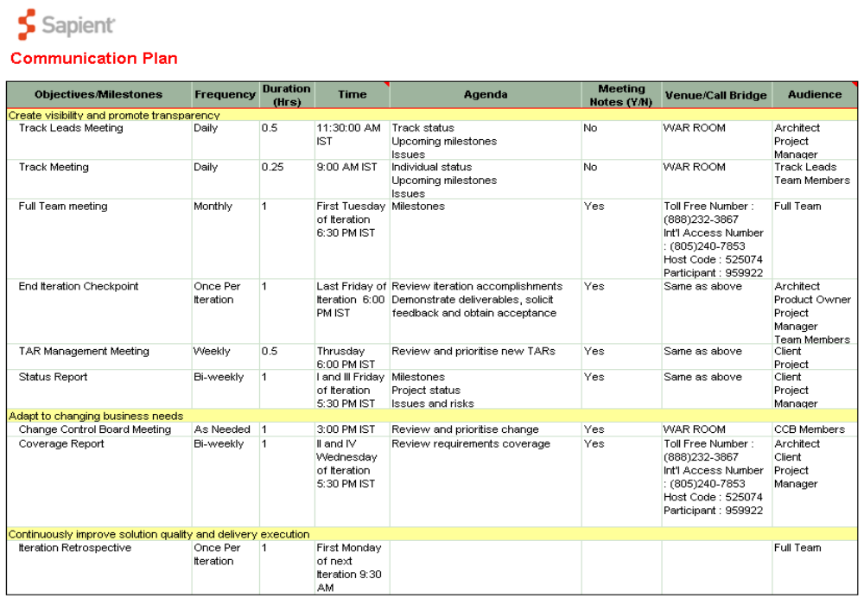
Notes:
Speaker Notes:
An example of Communication Plan (partial) is shown above

Slide 5
Plan Project
Purpose:
  Populate the integrated project management plan with content and create the high level plan for the project
Objective:
  Establish overall project plan and milestones of the engagement
Activities:
  Create Integrated Project Management Plan on RS2 Wiki
  Create High Level plan for the project with timelines, key milestones and dependencies
Mandatory Artefact:
  Integrated Project Management Plan
  High Level Plan

Slide 6
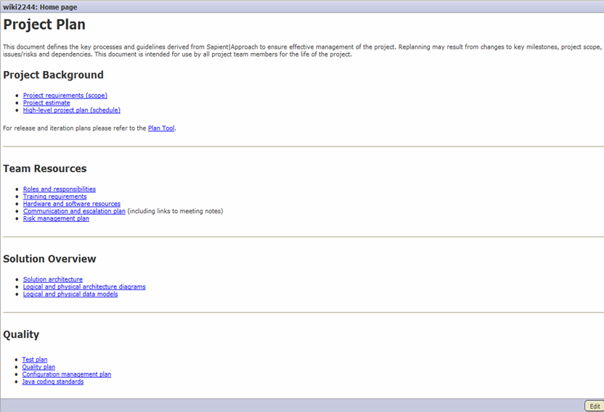
Integrated Project Management Plan on RS2 Wiki

Slide 7
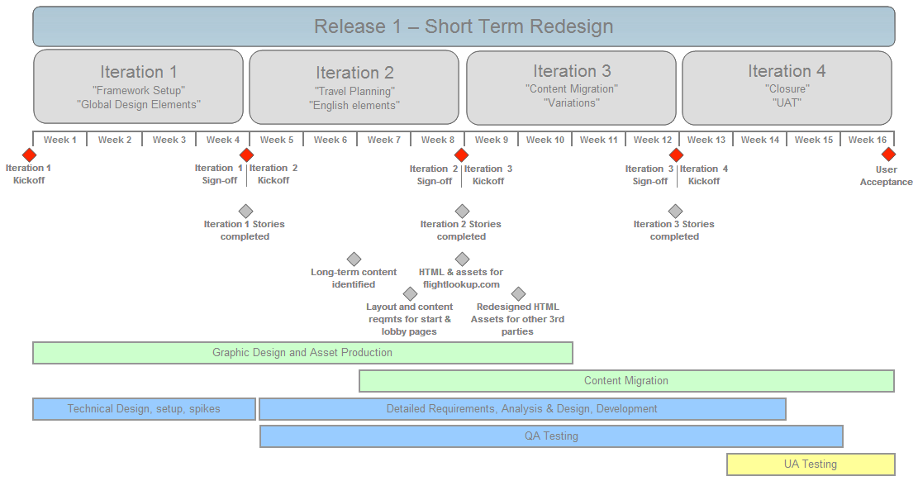
High Level Plan

Slide 8
Plan Releases
Purpose:
  Plan the next release or two to ensure that value is delivered
Objective:
  Define major objectives and timeframes for releases
  Generate/refine the list of stories for the planned work
  Construct a plan for the next release or two
Activities:
  Establish key release dates and associated functionality
  Define/refine stories, including business value and risk
  Estimate stories
  Determine iteration length
  Allocate stories to iterations (develop release plan)
Mandatory Artefact:
  Release Plan

Slide 9
Plan Releases - Best Practices
Release every 3-4 iterations (never more than 4 months)
Schedule a release even if it is only to the QA environment
Know that the release plan will change, don’t try to get too precise
Work with client to identify target functionality for first release: what is their “minimal marketable feature set?”
  The smallest subset of the solution’s capabilities that would have value for the client
Build some buffer into the iteration immediately following a release to pay off any “technological debt”

Slide 10
Kick-off Project
Purpose:
  To position the project team for success
Objective:
  This activity aims at ensuing:
  S|A Adoption Plan has been created and approved for the project
  The team is ramped up
  Work Areas are established
  Any critical training is provided before the project gets started
Activities:
  Fill and get the Adoption Plan approved for the project
  Create Quality Plan
  Establish Team work areas
  Ramp-up the Project team
  Capture Issues and Risks
Mandatory Artefact:
  Approved S|A Adoption Plan
Notes:
Speaker Notes:
Project Kick-off should done using the Kick-off Checklist.

Slide 11
Plan Iteration
Purpose:
  To prioritise and select what will be delivered in the next iteration
Objectives:
  Review project milestones
  Collaborate with the Product Owner to prioritize and confirm the scope of an iteration
  Determine the stories to implement by track in the upcoming iteration
Activities:
  Review current iteration’s progress (review metrics, gather data)
  Update product backlog
  Draft strawman iteration plan that includes recommended stories
  Finalize story selection with client based on expected velocity and client value
  Assign stories to tracks and update release plan
Mandatory Artefact:
  Iteration Plan

Slide 12
Plan iteration – Best Practices
Avoid inter-story dependencies within an iteration as they can slow your velocity
Try and keep dependencies within a track
  Too many inter-track dependencies may imply a non-optimal team structure
Build your iteration plan to include committed “must have” stories and “nice to have” stories that act as a stretch goal for the team
When breaking stories into tasks, strive for small tasks that can be implemented within a matter of hours
Notes:
Speaker notes:
The capability to add „Nice to have“ stories is not yet available in the current version of the RS Planning Tool, but will be included in future releases. However you can use naming conventions to help indicate priorities of stories eg prefix a story with H/M/L

Slide 13

Kickoff Iteration
Purpose:
  To agree on what the scope for the iteration is and start
Objectives:
  Communicate the planned work to the team
  Create a list of tasks with estimates and owners, grouped by story
  Generate a list of functional tests for story completion, validation
Activities:
  Client/client proxy presents the requirements for each story
    Focus on implementation level details (Error cases, Boundary conditions, Integration points)
    Talk through functional tests (tester records)
  Team brainstorms and defines tasks (story by story)
    Preliminary design
    Task out story
    Estimate LOE for each task
Output:
  List of tasks per story
  List of functional tests

Slide 14
Kick-off iteration – Best Practices
Kick-off meeting should last no more than 1 day in total
Everyone participates in the kick-off meetings
If the team gets too tired, push off tasking all the stories until later
For the team members not in the same location as the client, start tasking out the stories earlier (with risk of rework if the client reprioritises your stories)

Slide 15
Set-up TAR Management Environment
Purpose:
  Establish an environment for managing TARs
Objective:
  To ensure that the environment required to systematically manage TARs is set up as the project begins
Activities:
  Agree on TAR classification, prioritization and acceptance criteria with client
  Define and close with the client a TAR review and management process
Mandatory Artefact:
  TAR Management Life Cycle
  Classification and Prioritization criteria for TARs

Slide 16

Questions?

